Slide 1
Engaging students with Texas public opinion polling in learning materials and in the classroom
James Henson
The Texas Politics Project
TCCTA 2024

Slide 2
We will cover:
Public opinion polling in teaching (the “why”)
Some examples/applications from original polling (the “how”)
Along the way: Some new data of interest from the 2024 University of Texas/Texas Politics Project Poll

Slide 3
Why is public opinion important in civic education about politics?
Informs and educates individuals about what the public thinks
Empowers the public by including them in the discussion of policy
Provides a check on policymakers in terms of alignment and accountability
May guide public policy (when united and activated) or, at least, party positions

Slide 4
Flipside: Critical evaluation is important, too
Requires some basic attention to mechanics of polling and due diligence in promoting information literacy around poll interpretation

Slide 5
Can help to meet some of the core objectives of GOVT 2305/2306
Critical thinking skills: “…analysis, evaluation, synthesis of information”
Communication skills: “...effective development, interpretation and expression of ideas through written, oral, and visual communication”

Slide 6
Some instructional uses of polling: Ideas for the classroom

Slide 7
Example of conceptual application for primary election season: Ideological tensions within the parties

Slide 8
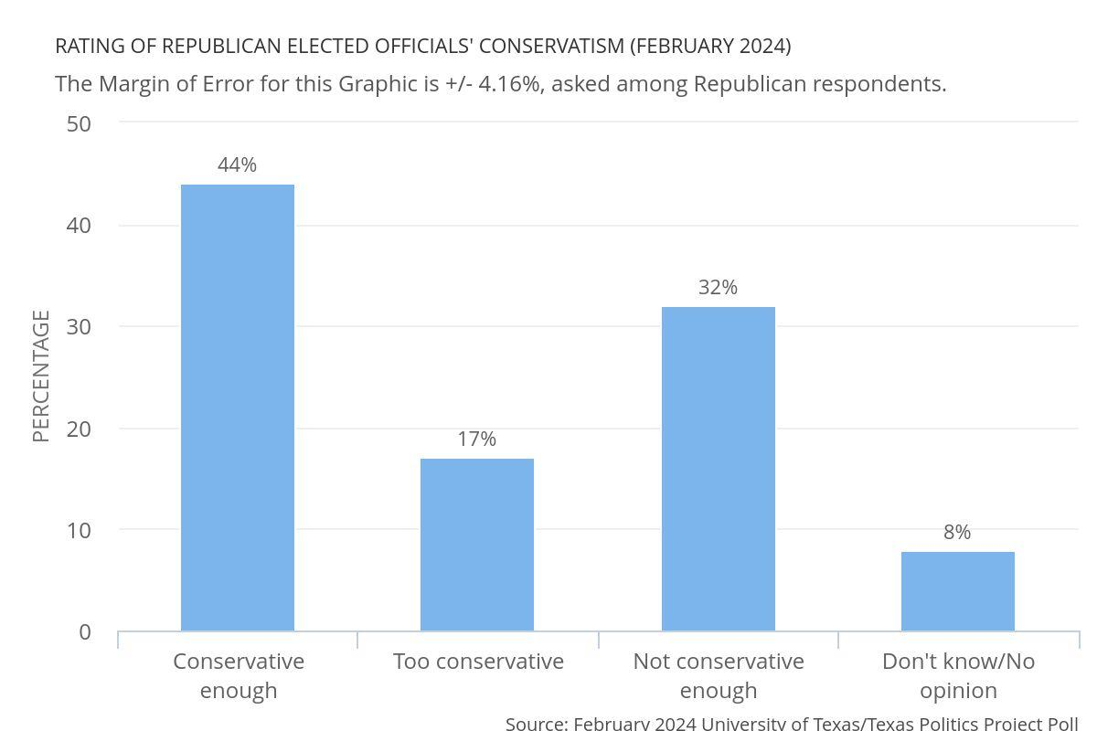

Slide 9
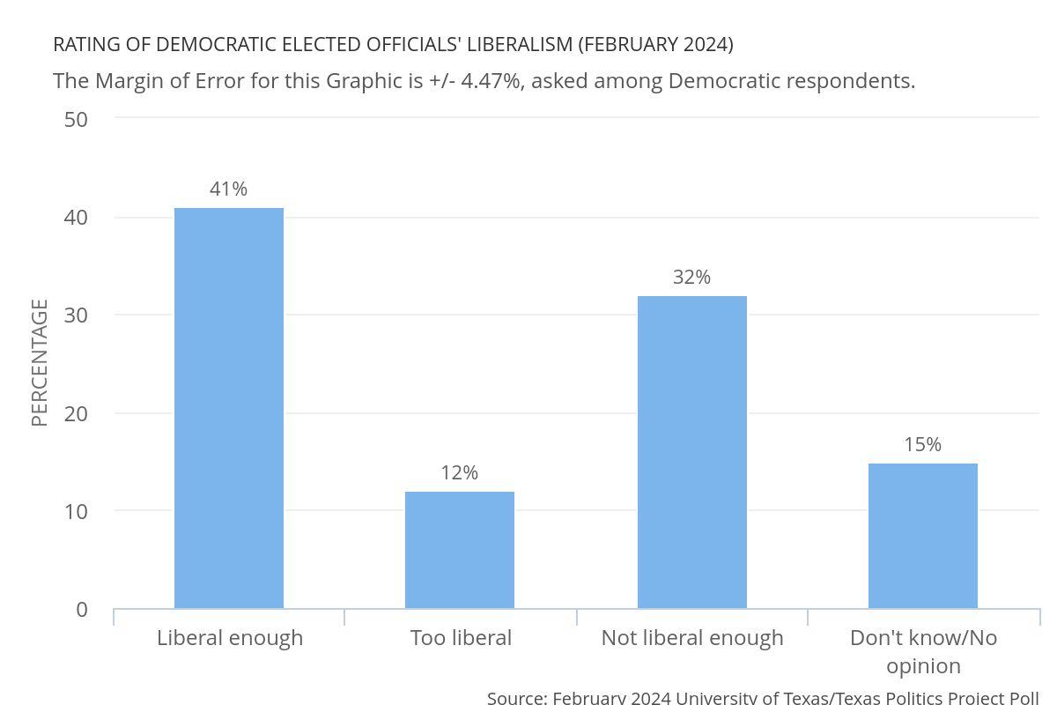

Slide 10
Instructional applications/takeaways
Illustration of how major parties are forced to manage ideological differences
Very current dynamics of primary conflicts (at least one axis in the current setting)
Can help explain different electorates in primary and general elections (in conjunction with breakdowns by ideological intensity)

Slide 11
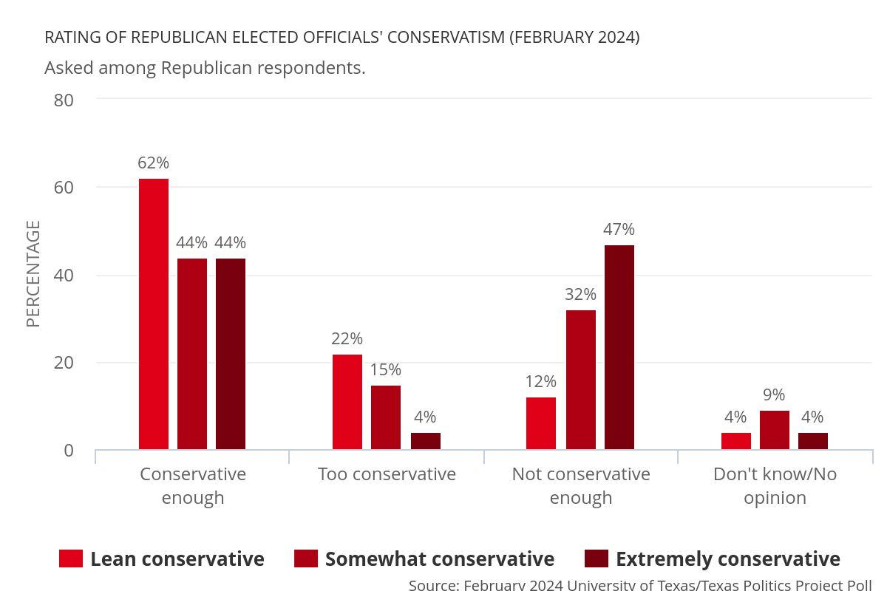

Slide 12
Another example of conceptual application: Negative partisanship

Slide 13
Negative partisanship (working definition)
The tendency of a voters’ identification with one party to be significantly or primarily driven or outweighed by hostility toward the other party

Slide 14
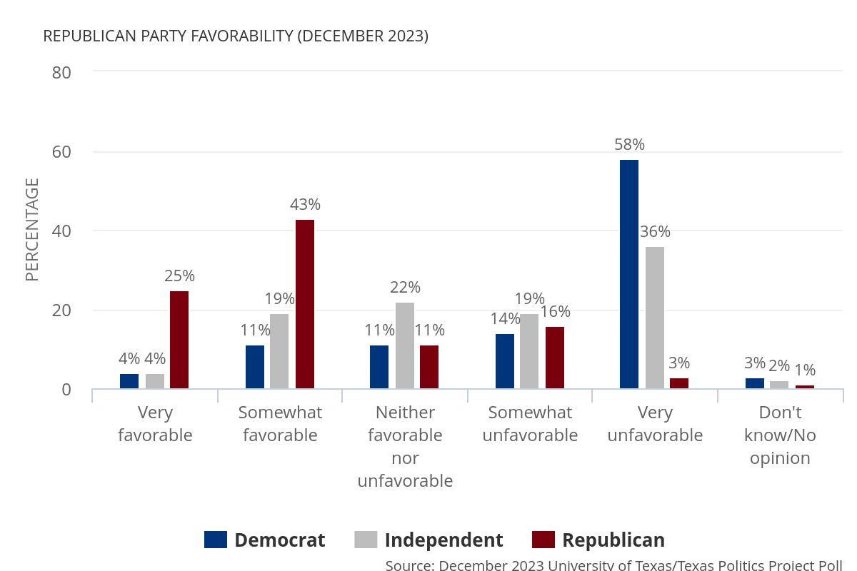

Slide 15
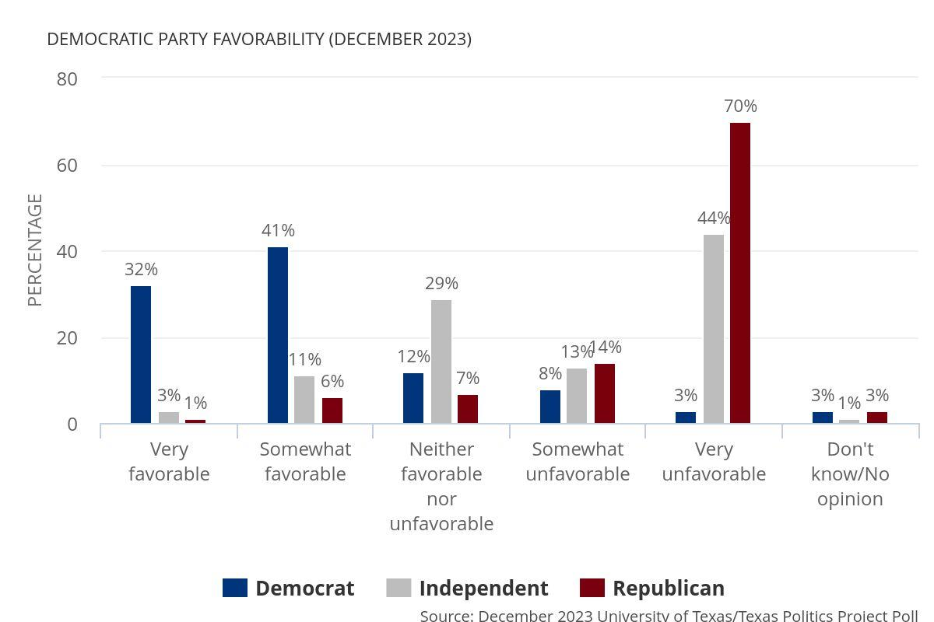

Slide 16
Instructional applications
Discussion of how negative partisanship might inform campaign themes
Discussion about the consistency in the partisan distribution of the vote even when events or circumstances might lead to different expectations

Slide 17
Instructional applications: Centrality of immigration and border security in Texas politics

Slide 18
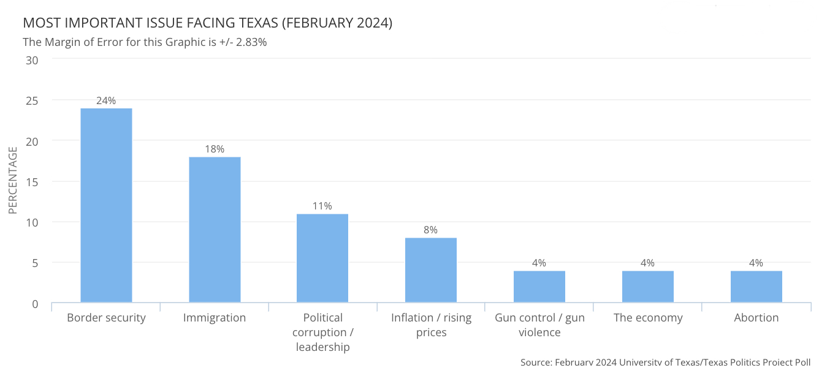

Slide 19
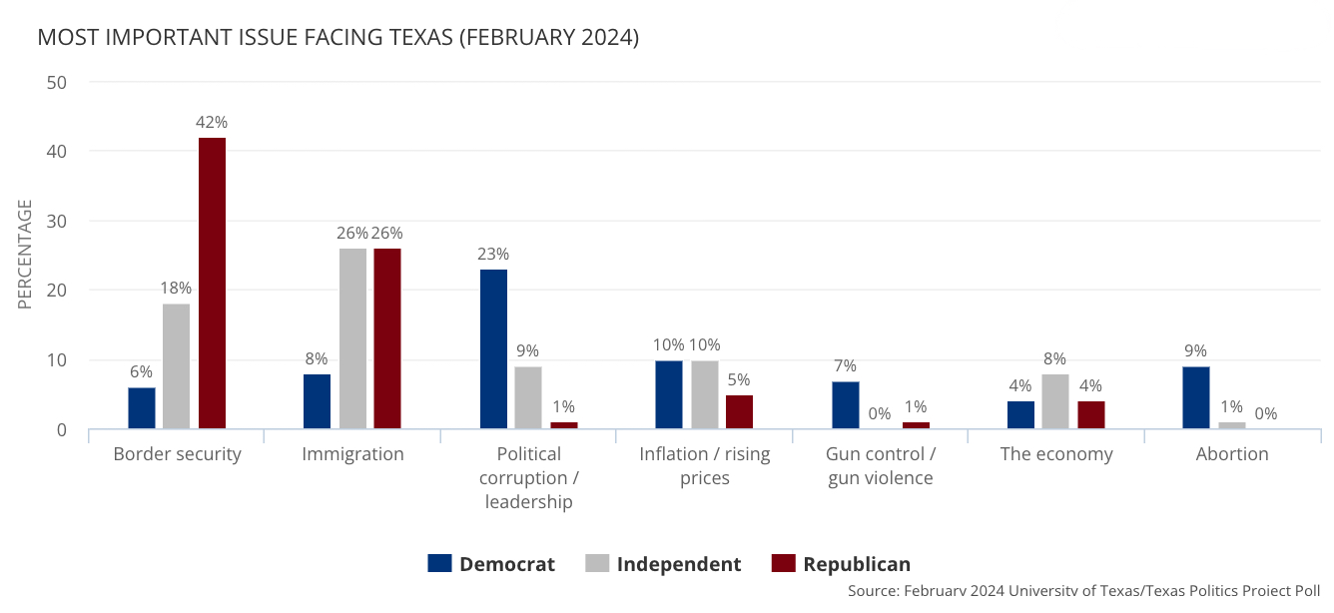

Slide 20
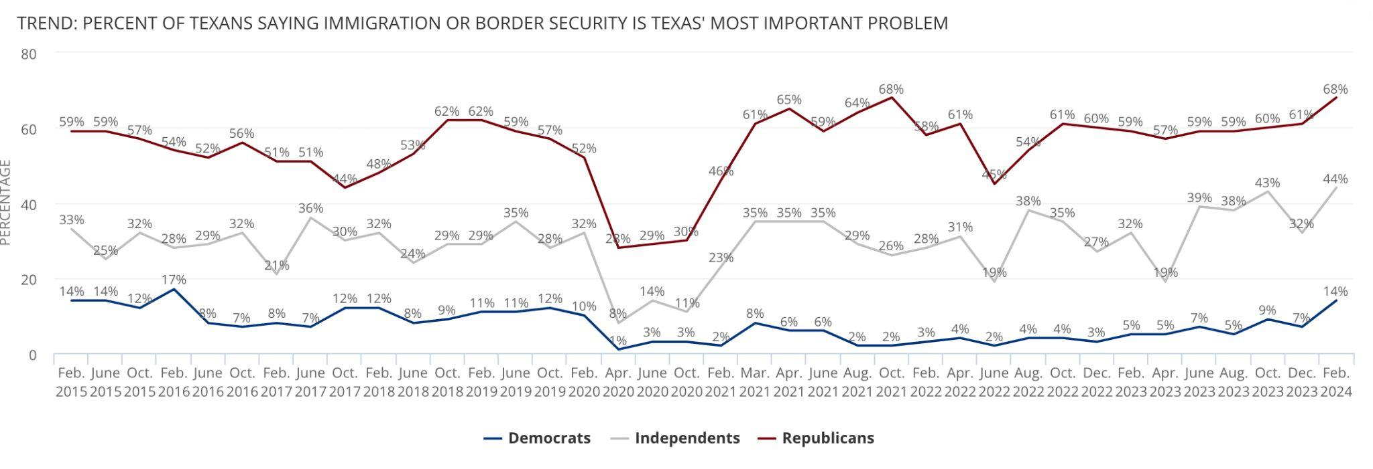
On the website: https://texaspolitics.utexas.edu/chart/trend-percent-texans-saying-immigration-or-border-security-texas-most-important-problem

Slide 21
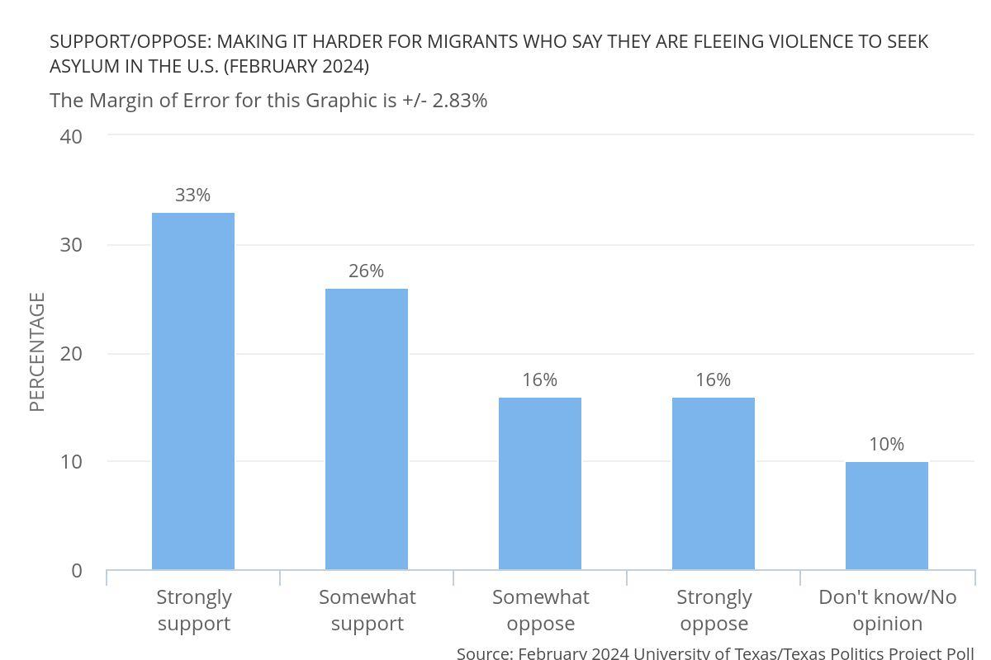

Slide 22
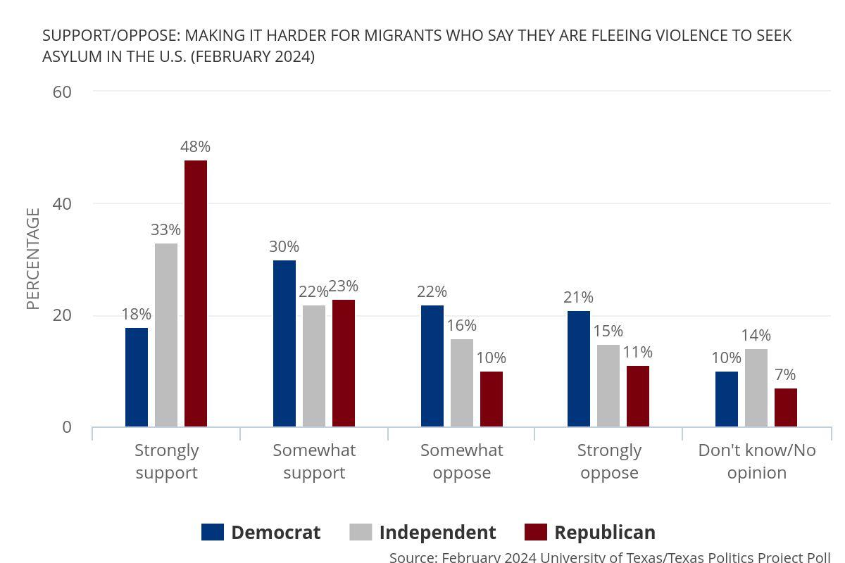

Slide 23
Instructional applications
Concept of issue salience (which also makes it a reliable issue students have heard about)
Linkages among salience, direction of attitudes, and policy responses
Teaching about campaign strategy (e.g., mobilizing “issue publics”)

Slide 24
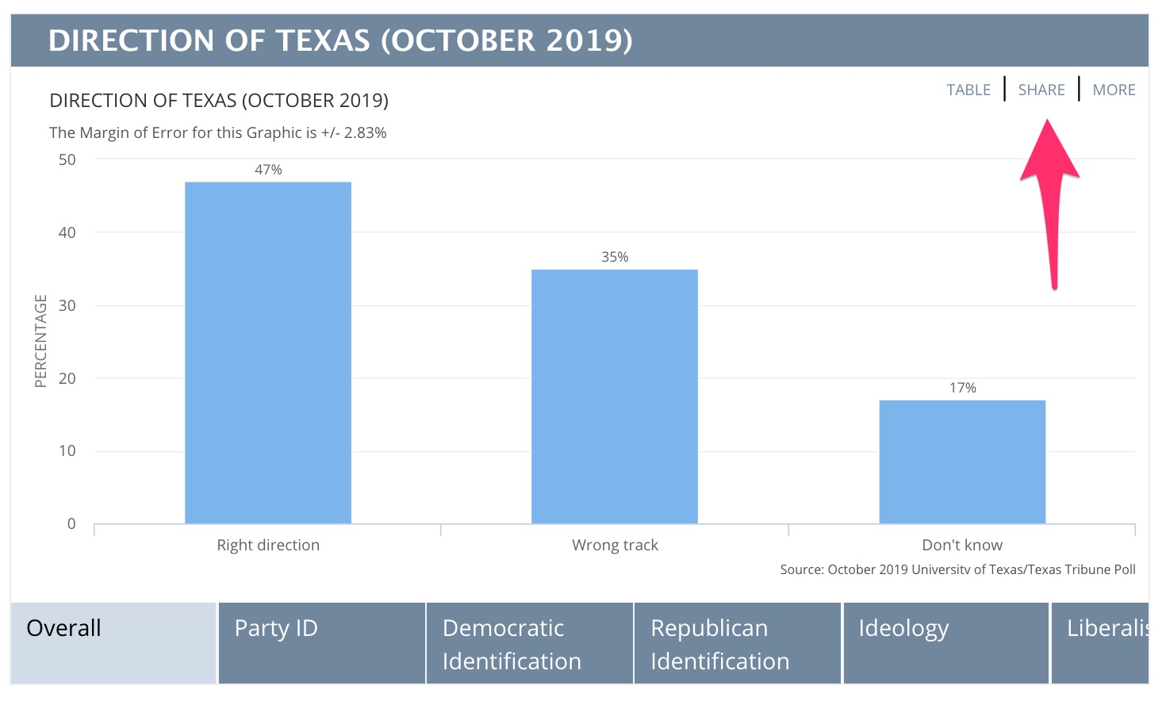
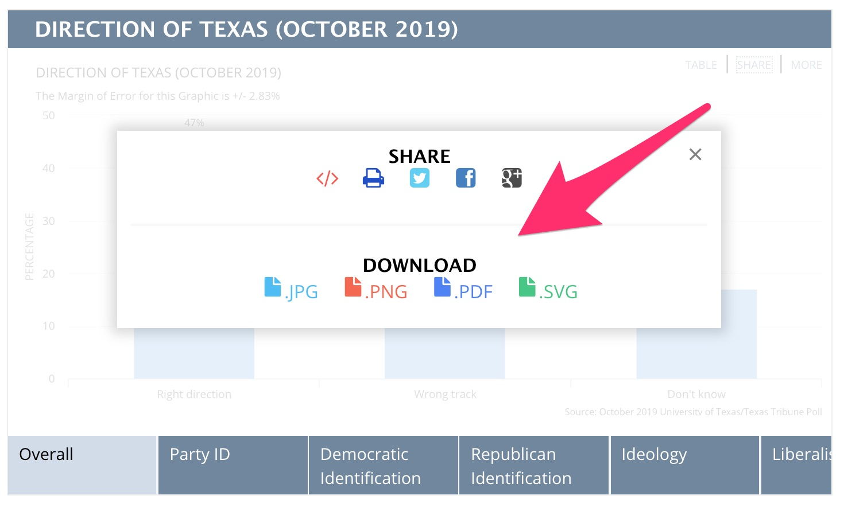
DIY decks/handouts/webpages using the Texas Politics Project website
Polling data with thousands of downloadable graphics and raw data: https://texaspolitics.utexas.edu/polling-data-archive

Slide 25
Instructional uses of polling: Examples from the Soomo webtext

Slide 26
Example: Polling students about their attitudes toward police
(in the “Criminal Justice System” chapter)

Slide 27
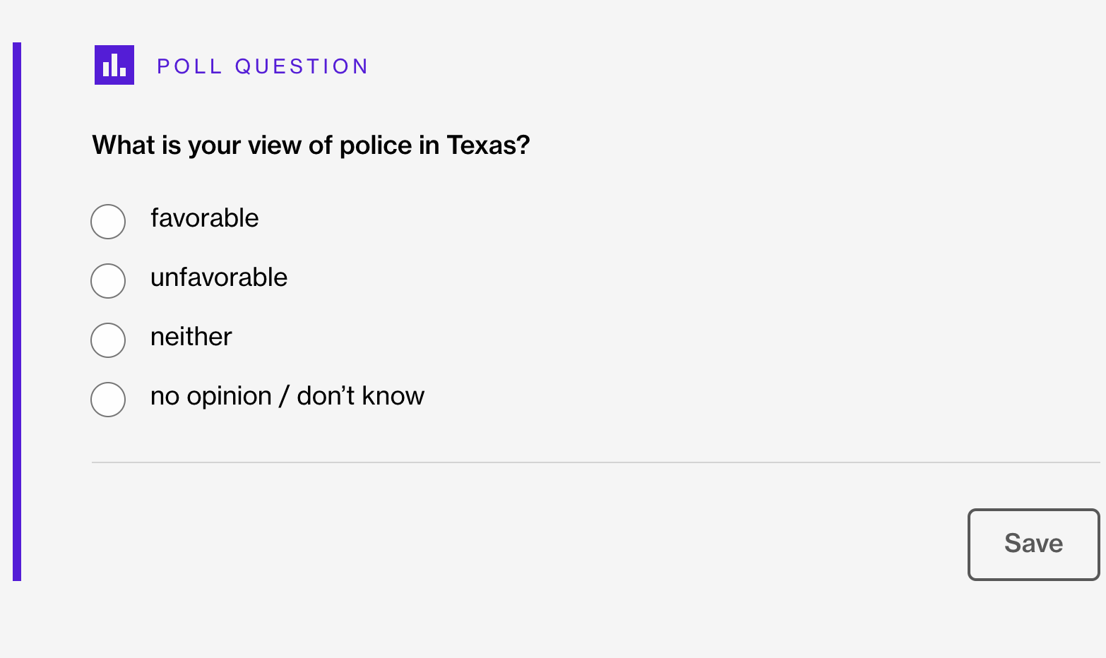

Slide 28
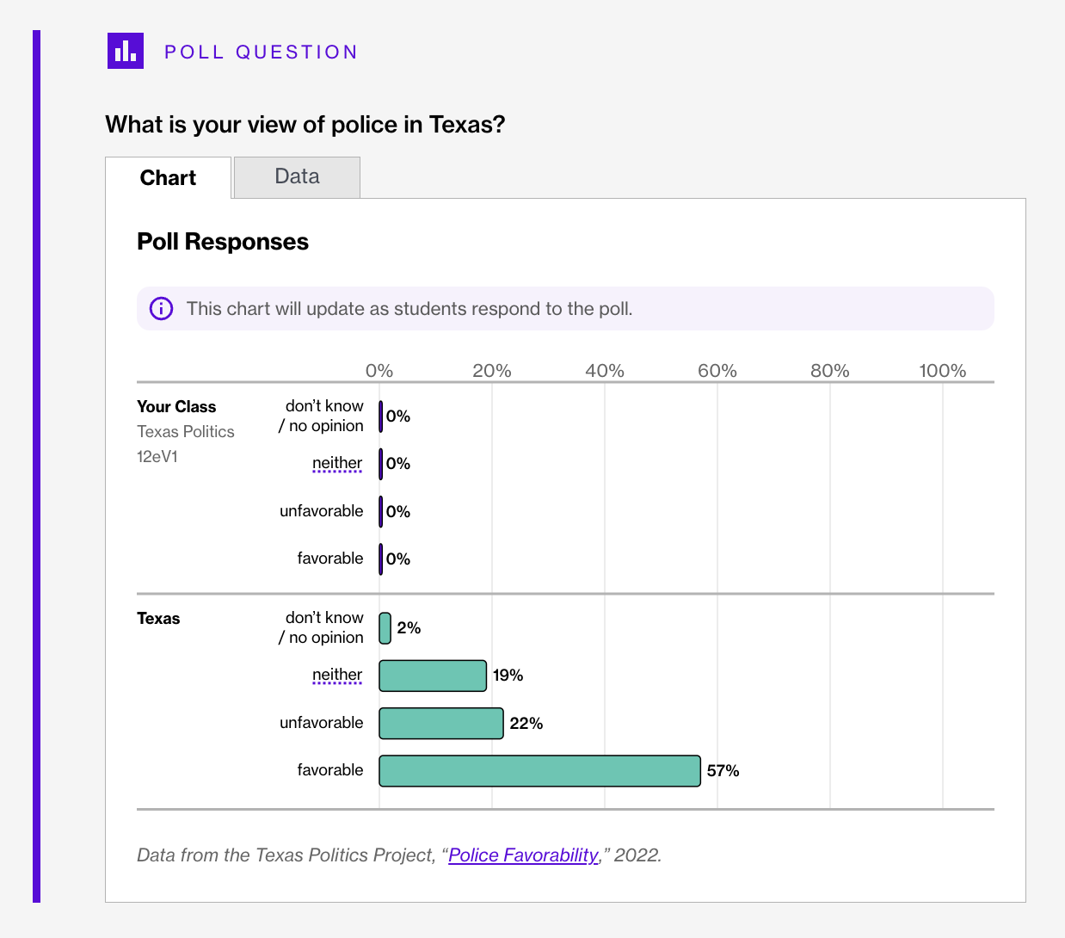

Slide 29
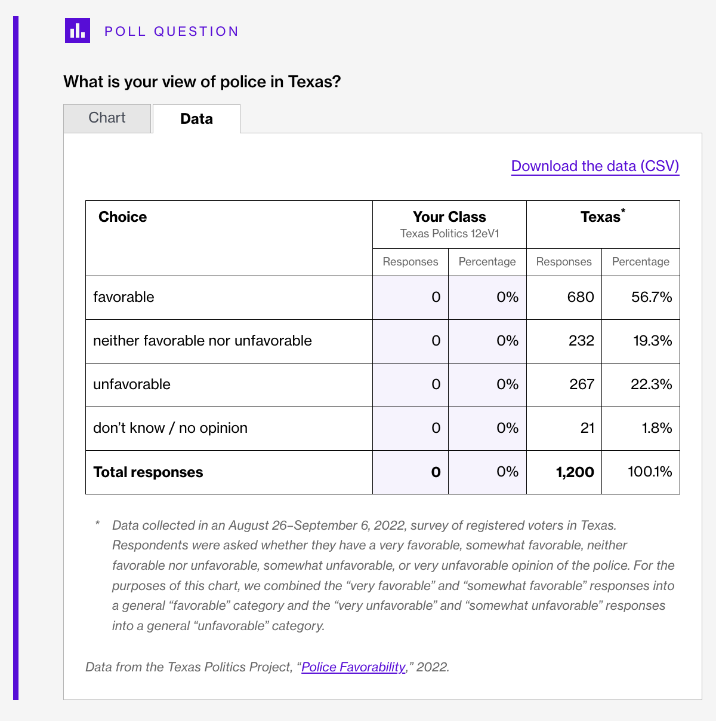

Slide 30
Example: Polling students on Texas model of governing
(in the “Political Parties” chapter)

Slide 32
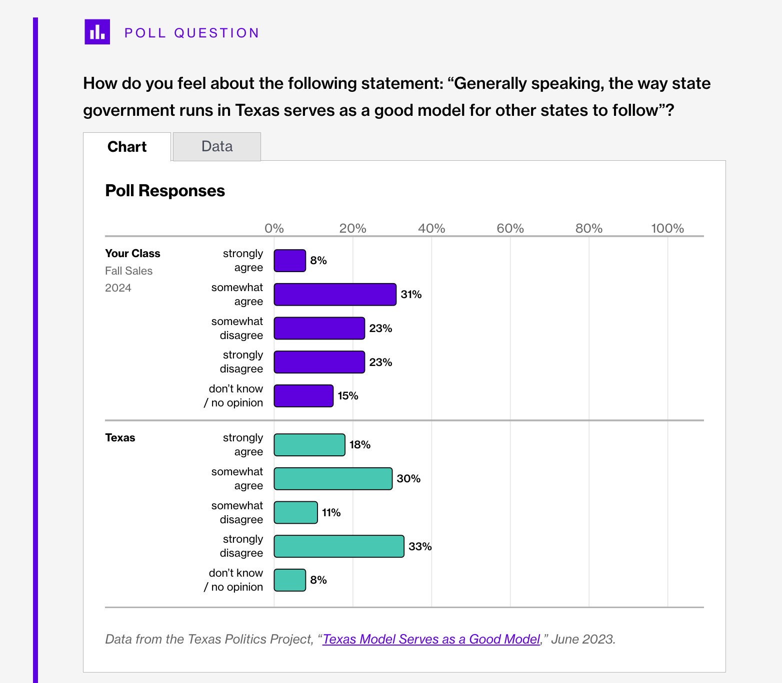

Slide 33
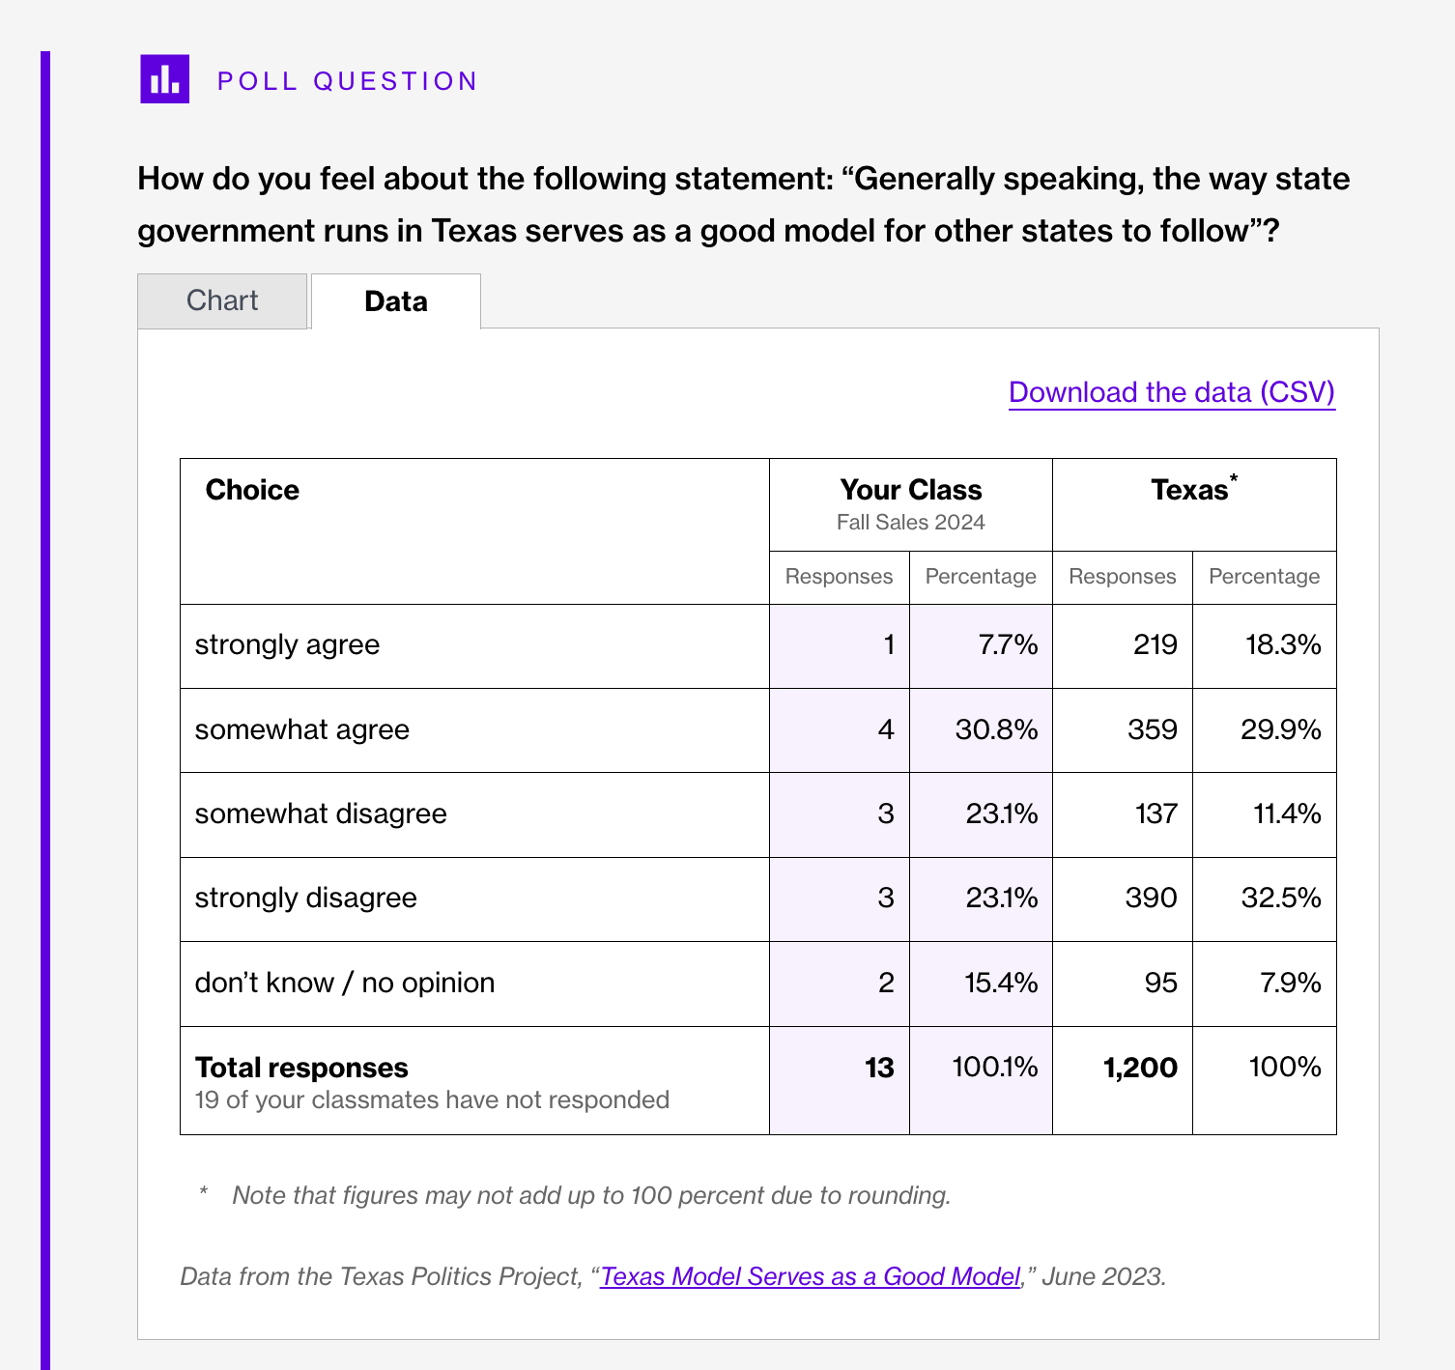

Slide 34
Benefits of the design of embedded, interactive poll comparisons
Tool for class discussion about politics, concepts, and methods through comparison with state results
Student engagement with material
Reinforcement of content
Student engagement with politics
Sense of civic membership

Slide 35
“I actually enjoyed using this webtext, I found it interesting and I really liked how it
shows what’s ACTUALLY going on in politics, such as what the republican and democratic parties voted on etc. I also like that we have the option to participate in polls and voice our opinions”
—Texas Politics Student Fall 2023 Survey Response

Slide 36
More interactive poll questions in Texas Politics
Campaign finance
Attention to the Texas Legislature
Police–community relations
Party affiliation
Issue salience (“most important problems facing Texas”)
Same-sex marriage

Slide 37
Advantages of textbook integration of active Texas Politics Project Polling
Regular updating of results because we can coordinate updates with polling project
Ability to update subjects of poll questions based on user feedback
Added capacity to keep content fresh at the point of interaction with students

Slide 38
Resources
Polling data with thousands of downloadable graphics and raw data: https://texaspolitics.utexas.edu/polling-data-archive
Texas Politics webtext 12th Edition (Soomo Learning): https://www.soomolearning.com/courses/texas-politics
Find content at the Texas Politics Project blog: texaspolitics.utexas.edu/blog
The Second Reading Podcast: Spotify, Stitcher, Apple Podcasts

Slide 39
Thanks—and keep in touch
Interested in updates? Use the form on the blog at our site or email me to be added to our email list: j.henson@austin.utexas.edu
Facebook: /texaspoliticsproject
Twitter/X: @TxPolProject, @jamesrhenson
Want more information about the 12th edition of Texas Politics?
Contact Tahnee Johnson, Senior Account Manager—Texas
tahnee.johnson@soomolearning.com www.soomolearning.com

